Slide 1


Slide 2
Agenda
Introduction
BT + Multimedia
Experimental
Conclusion

Slide 3
Agenda
Introduction
BT + Multimedia
Experimental
Conclusion

Slide 4
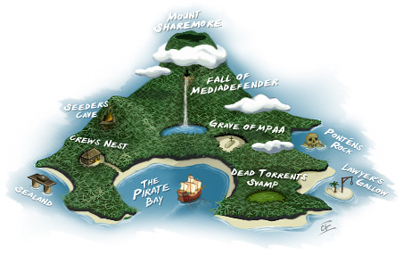
BitTorrent
Leech
down/up-load
Seed
upload
Swarm
overylay
Tracker
manager

Slide 5
Polices in BT
Rarest-first
least replicated chunks
Tit-for-tat
choking, deter free rider
Optimistic unchoking
reserver upload BW to random peers

Slide 6


Multimedia
Quality
Speed

Slide 7
Agenda
Introduction
BT + Multimedia
Experimental
Conclusion

Slide 8



BT + Multimedia
I’m scalable, efficient, cost-effective, self-improving, easy to deploy…
W-A-I-T !
Two problems:
Dowload NOT in sequence
Tit-for-tat
Marry Me

Slide 9



Work this out
Propose two modifications in BT:
Chunk selection policy
Neighbor selection policy

Slide 10
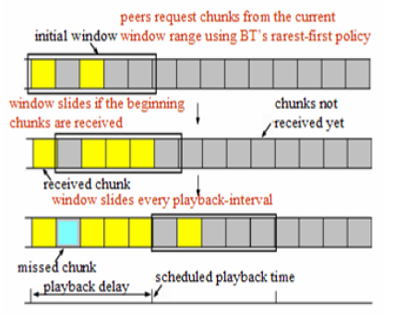
Chunk selection policy
NOT in sequence
Sliding window
w = db/c
w: size of window
d: playback delay
b: vido consumption rate
c: chunk size

Slide 11
Neighbor selection policy
Advantaged peers favor each other
Slower peers suffer from slow start
Each peer selects neighbors at random for the randomized chocking interval
At the beginning of every playback
Use tit-for-tat policy until the end of the playback duration to deter free riding
Once they have chunks to exchange peers

Slide 12
Agenda
Introduction
BT + Multimedia
Experimental
Conclusion

Slide 13
Experimental Setup

Slide 14

Experimental Setup
Homogeneous setting
All leeches within a sub-network have the same link band width
Assumed the idealized performance of TCP
Neglect network propagation
Ignore the packages used by peers to request chunks

Slide 15

Measure the performance
Success ratio
Normalized network throughput

Slide 16
Experimental Result

Slide 17
Chunk selection policy
Rarest-first policy (original BT)
Sequential policy
Sliding window and rarest-first policy

Slide 18
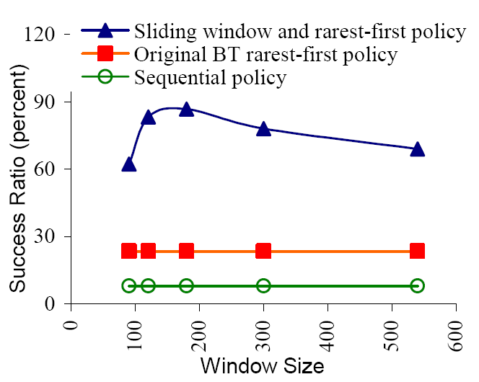
Chunk selection policy (continue)

Slide 19
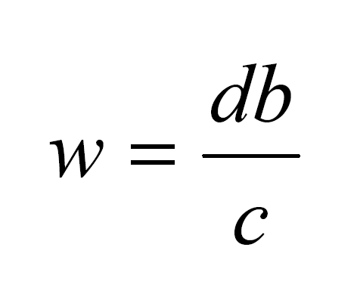

Window Size
d = the playback delay
b = the video consumption rate
c = chunk size

Slide 20

Neighbor Selection policy
BT-tit-for-tat
BT-randomized-tit-for-tat

Slide 21
Three types of Regions
Resource-rich ( r > b )
Resource-critical ( r ≈ b)
Resource-starved ( r < b )
b = video consumption rate
r = average observed download rate (4.048 Mbps)

Slide 22
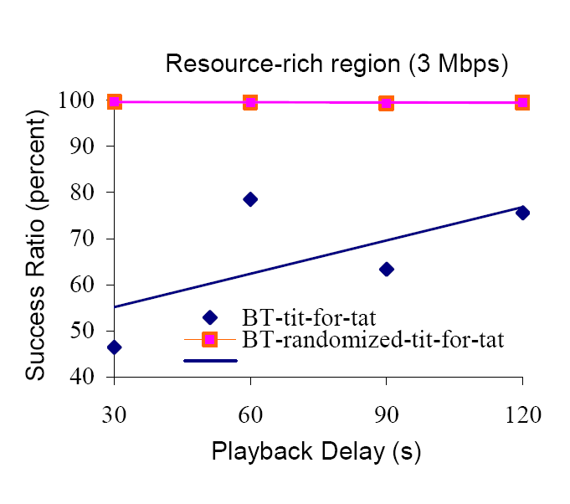
Success Ratio

Slide 23
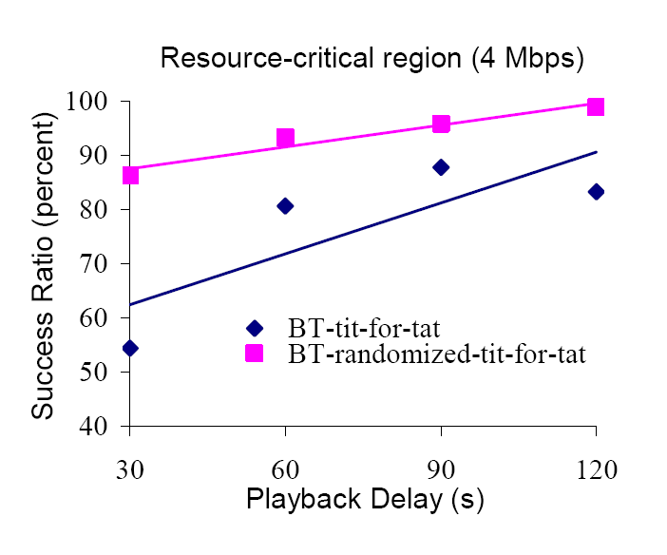
Success Rate (continue)

Slide 24
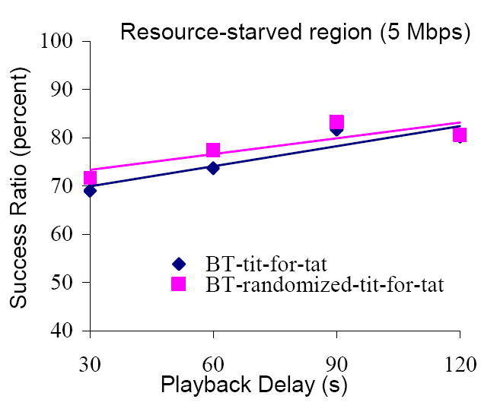
Success Rate(continue)

Slide 25

Normalized network throughput
The ratio of the total number of bytes uploaded by all the peers up until that time to the network capacity (i.e. total network bandwidth).

Slide 26
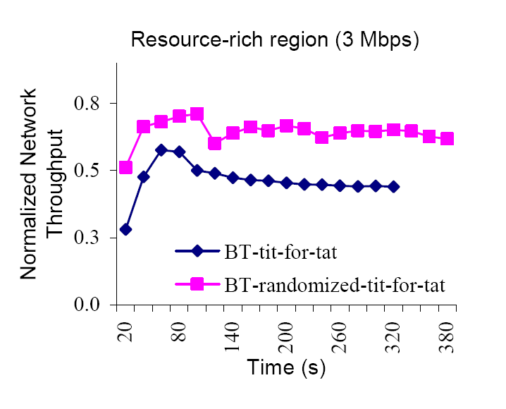
Normalized Network Throughput

Slide 27
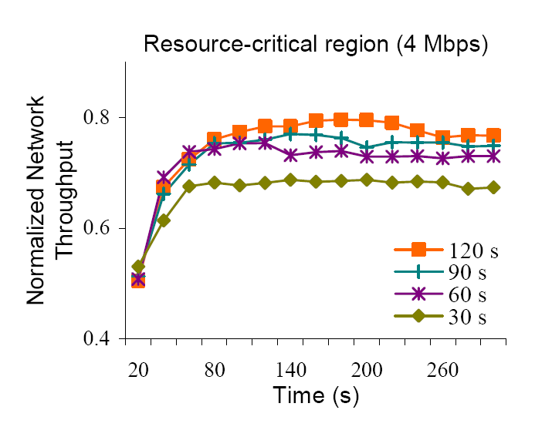
Normalized Network Throughput

Slide 28
Agenda
Introduction
BT + Multimedia
Experimental
Conclusion

Slide 29

Conclusion
Sliding Window
Randomized-tit-for-tat

Slide 30

Future Work
Control mechanism
playback delay VS QoS
Peer dynamicity
Join and leave

Slide 31


Thanks for your time
Any questions?

